Slide 1


Slide 2
The Heartbleed Bug
Affects OpenSSL v1.0.1 (released March 14, 2012) through v1.0.1f Sunday April 6, 2014
Reported by Neel Mehta (@neelmehta) of Google
Surprisingly simple bug: simple bounds checking bug
Surprisingly bad results: attacker can read up to 64k of private memory space

Slide 3
What’s at stake?
Long-term server private key
TLS session keys
Confidential data like passwords and session tokens
Session tickets used for session resumption

Slide 4
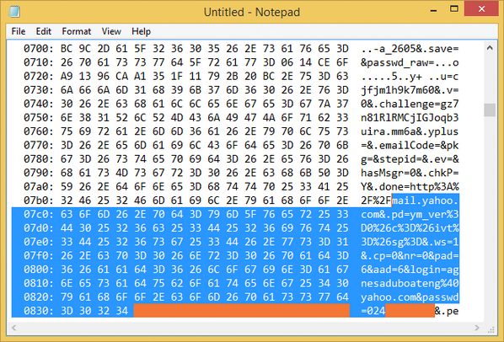

Slide 5
Bug in Depth
“The TLS Heartbeat mechanism is designed to keep connections alive even when no data is being transmitted. Heartbeat messages sent by one peer contain random data and a payload length. The other peer is suppose to respond with a mirror of exactly the same data.”

Slide 6
Bug in Depth
Data structure of the of the request:
struct {
HeartbeatMessageType type;
uint16 payload_length;
opaque payload[HeartbeatMessage.payload_length];
opaque padding[padding_length];
} HeartbeatMessage;

Slide 7
Bug in Depth
Type
Length <- attacker controlled
Payload
Attacker reports longer length then payload, server then replies with payload + extra info from adjacent memory

Slide 8
Bug in Depth
The incoming (adversarially-generated) data contains a payload length ("payload") which is trusted without bounds checks.
OpenSSL then allocates a buffer for its response, and copies "payload" data bytes from the pointer "pl" into it.
Unfortunately, there's no check to make sure that there are actually "payload" bytes in data, or that this is in bounds.
Hence the attacker gets a slice of data from main memory -- one that's up to 64KB in length.

Slide 9
Remediation
Update to new OpenSSL version
Switch to IIS
Recompile sources with DOPENSSL_NO_HEARTBEATS flag

Slide 10
Resources
http://blog.cryptographyengineering.com/2014/04/attack-of-week-openssl-heartbleed.html
http://blog.existentialize.com/diagnosis-of-the-openssl-heartbleed-bug.html
https://tools.ietf.org/html/rfc6520#page-5

